Slide 1

Spotify – Web Player: Music for Everyone
Project Mentor: Parimal sir
Project submitted by:
Hiral Kshatri (202326900042)
Jash Kevadiya (20232600039)
Naisargi Prajapati (202326900095)

Slide 2
INTRODUCTION
In department of animation under b.sc IT course in sem II we are given project in extrenal exam. In which project was asked to be done solo or in group. In which I(202326900042), my classmate Jash Kevadiya(202326900039) and Naisargi Prajapati(20232600095) have worked together under this project.
I express my profound gratitude to Mr. Parimal Sir (Assistant professor), Department of Animation for the valuable help and guidance in the preparation of this Report. I would like to extend my sincere thanks to all Lab Assistants and all other staff members of B.sc IT Data Management & visual insight. Finally, I would also wish to record my gratefulness to all my friends and classmates for their help.
We have no valuable words to express our thanks to everyone for the valuable advice and suggestions for the corrections, modification, and improvement did enhance the perfection in performing our job well

Slide 3

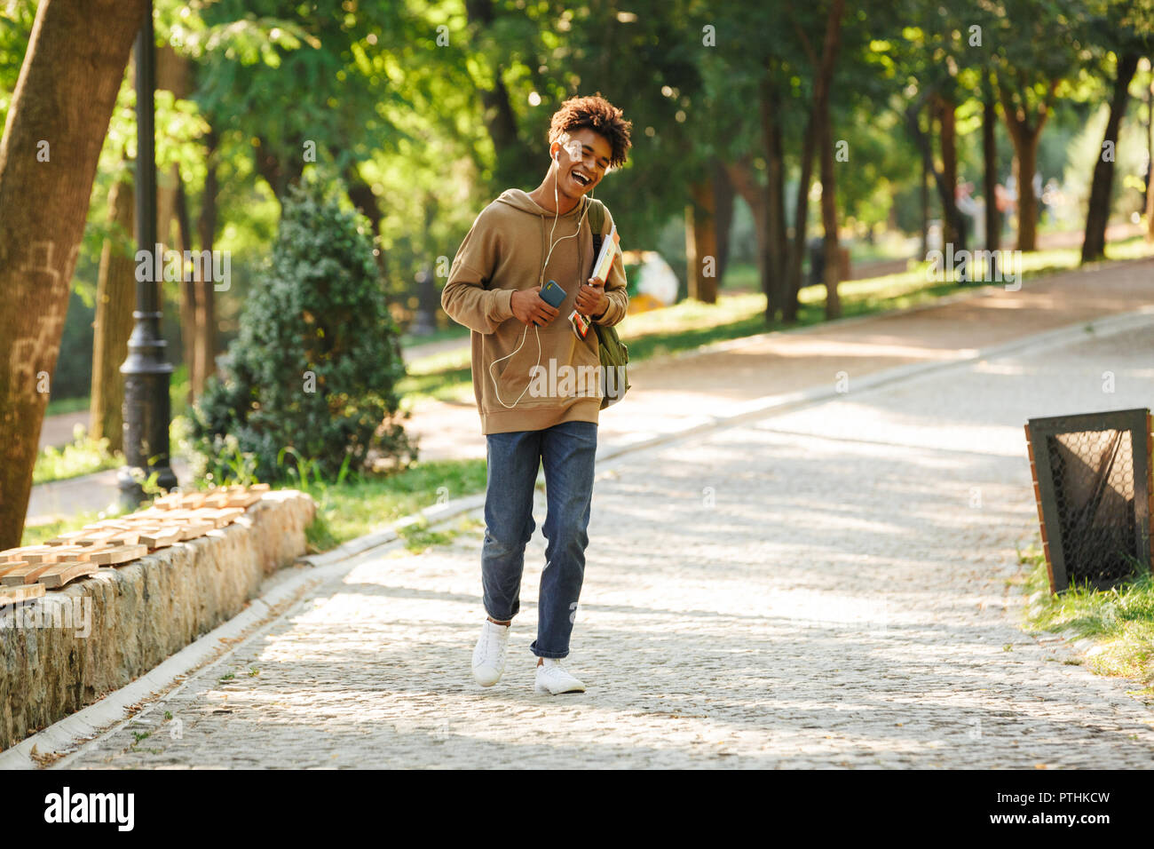

Purpose
To unlock the potential of human creativity by giving a million creative artists the opportunity to live off their art and billions of fans the opportunity to enjoy and be inspired by it.

Slide 4



Used Languages:
HTML
CSS
JavaScript

Slide 5
System Planning
HTML:
The provided HTML document outlines the structure of a Spotify-like web player interface. Here's a detailed breakdown of its components:
HTML Structure
Head Section
Meta Tags: Includes charset and viewport settings for responsive design.
Stylesheets: Links to style.css and utility.css for styling.
Favicon: Links to a Spotify icon (spoify_icon.ico).
Title: Sets the page title to "Spotify - Web Player: Music for everyone".

Slide 6
Body Section
Main Container: The main content is wrapped in a div with the classes container flex bg-black.
Left Sidebar: A sidebar with class left containing:
Home Section: Includes a logo and navigation items (Home, Search).
Library Section: Titled "Your Library" with placeholders for a song list and footer links (Legal, Safety & Privacy, Cookies, About Ads, Accessibility).
Right Content Area: Main content area with class right bg-grey p1 containing:
Header: Contains navigation controls and buttons for "Sign up" and "Log in".
Playlist Section: Titled "Spotify-Playlist", displaying multiple playlist cards with images, titles, and descriptions.
Playbar: A control bar at the bottom with seek bar, song info, playback controls (previous, play, next), volume control, and song time display.
Notes on Specific Elements
SVG Icons: Used for navigation arrows and playback controls to maintain scalability and visual clarity.
Playlist Cards: Each card includes a play button (SVG), image, title, and description. The cards are differentiated using the data-folder attribute.
Footer Links: Each link points to various Spotify legal and policy pages.

Slide 7
External Files
Stylesheets: The design relies on style.css and utility.css for styling.
JavaScript: Functionality is managed by script.js.
Example Usage
This document can be a basis for a web-based music player, mimicking Spotify's interface. With proper backend integration and JavaScript functionality, it could dynamically load playlists, handle user authentication, and manage playback controls.
Potential Improvements
1. Accessibility: Ensure all interactive elements are accessible via keyboard and screen readers.
2. SEO: Add relevant meta tags and improve content semantics for better search engine optimization.
3. Responsiveness: Ensure the layout adjusts well on various screen sizes.
4. Interactivity: Enhance with JavaScript for dynamic content loading and user interactions.

Slide 8
CSS:
General Styles (style.css)
Fonts: Uses the "Roboto" font family from Google Fonts.
Variables: Defined a custom property --a initialized to 0.
Reset: Resets margin and padding for all elements.
Body: Sets background to black and text color to white.
Containers:
left and right have specific width settings and padding.
home and library sections have padding and background color.
Specific Styling:
Home List Items: Flexbox layout with gap and padding; bold text.
Library Footer: Flexbox layout with small font size, grey color, and gap; positioned at the bottom.
Header: Flexbox layout for spacing between elements; background color set.
Card Container: Flexbox layout for playlist cards; supports wrapping and scrolling with a max height.
Cards: Relative positioning, background color, padding, border radius, and hover effects.
Play Bar: Fixed position with styles for seek bar, song info, control buttons, and volume control.

Slide 9
Utility Styles (utility.css)
Flexbox Utilities: Classes for display: flex, justify-content: center, and align-items: center.
Background and Color Utilities: Classes for setting background color to black and text color to white.
Border and Rounded Corners: Classes for borders and rounded corners.
Margin and Padding: Utility classes for consistent spacing.
Scrollbar Customization: Custom styles for scrollbar appearance.
JavaScript:
Variables and Functions
CurrentSong: An instance of the Audio object to manage audio playback.
songs: An array to store the list of songs fetched from the server.
Currfolder: A string to store the current folder path.
minutes(seconds) A helper function to format time in minutes and seconds.

Slide 10
getSongs(folder)
1. Fetch songs: Makes an HTTP request to fetch the list of songs from the specified folder.
2. Parse response: Converts the response into HTML, extracts song links ending in .mp3, and stores them in the songs array.
3. Display songs: Updates the song list UI with the fetched songs and attaches click event listeners to each song to handle playback.
playMusic(track, pause = false)
1. Set source: Sets the src of the currentSong object to the selected track.
2. Play/Pause: Plays the song unless the pause parameter is true.
3. Update UI: Updates the current song information and the initial time display.
displayalbums()
1. Fetch albums: Makes an HTTP request to fetch the list of albums (folders) in the songs directory.
2. Display albums: Processes the response to identify folders and potentially display them (though the function seems incomplete as it doesn’t update the UI).

Slide 11
main()
1. Initialize: Fetches the initial list of songs and plays the first one in pause mode.
2. Display albums: Calls the displayalbums() function.
3. Event listeners:
Play/Pause: Toggles between playing and pausing the current song.
Time update: Updates the song’s current time and seek bar position as the song plays.
Seek bar: Allows users to seek within the song by clicking on the seek bar.
Previous/Next: Plays the previous or next song in the list.
Volume control: Adjusts the song volume based on user input.
Album click: Loads the song list for the selected album.
Mute/Unmute: Toggles between muting and unmuting the song.
Execution
The main() function initializes the application by fetching the initial set of songs and setting up the UI and event listener

Slide 12
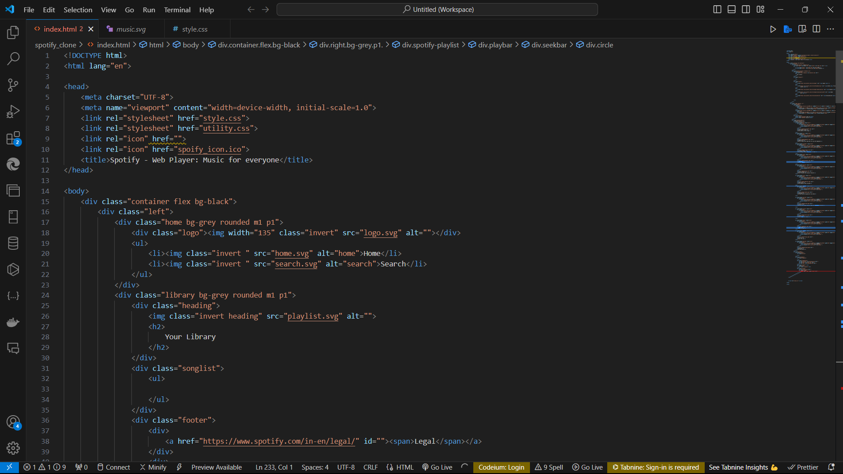
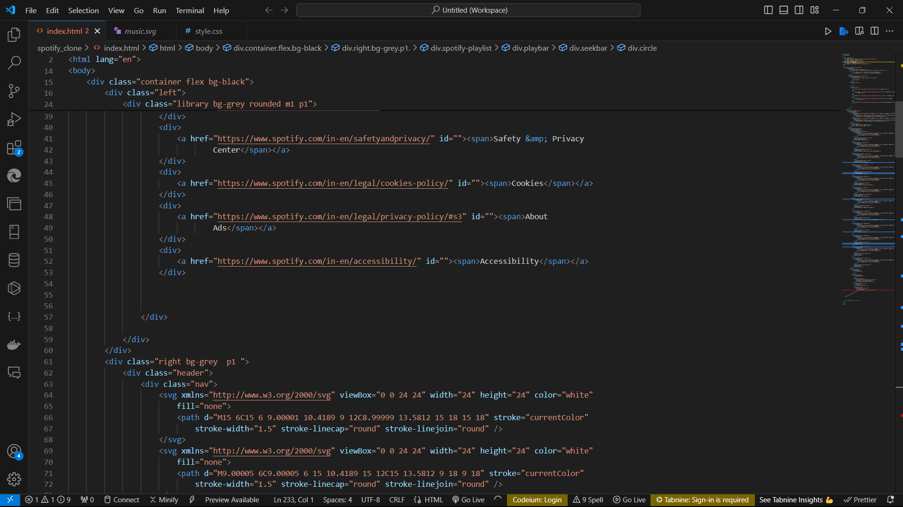
CODE(index.html)

Slide 13
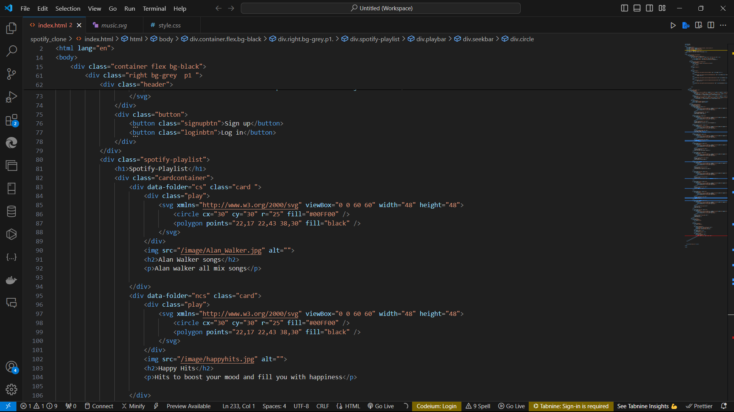
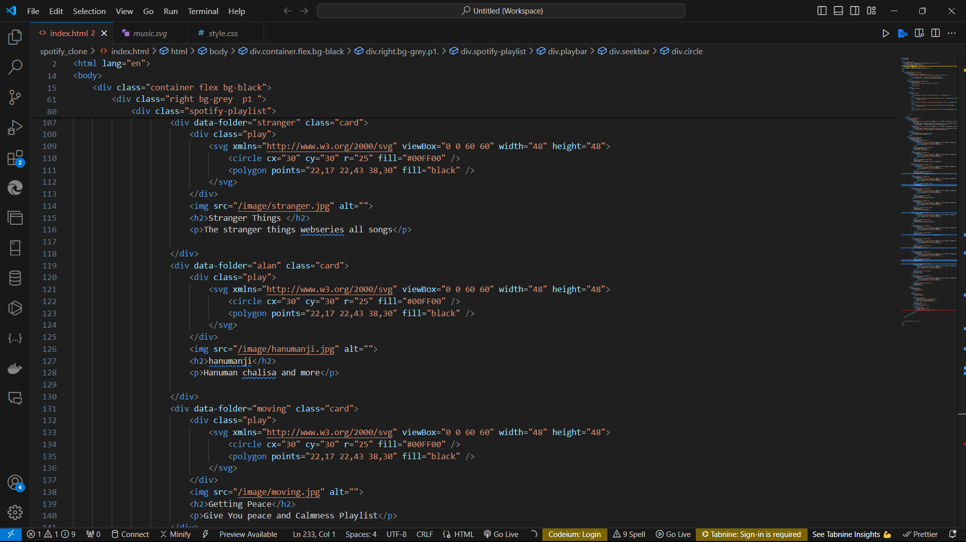
Index.html

Slide 14
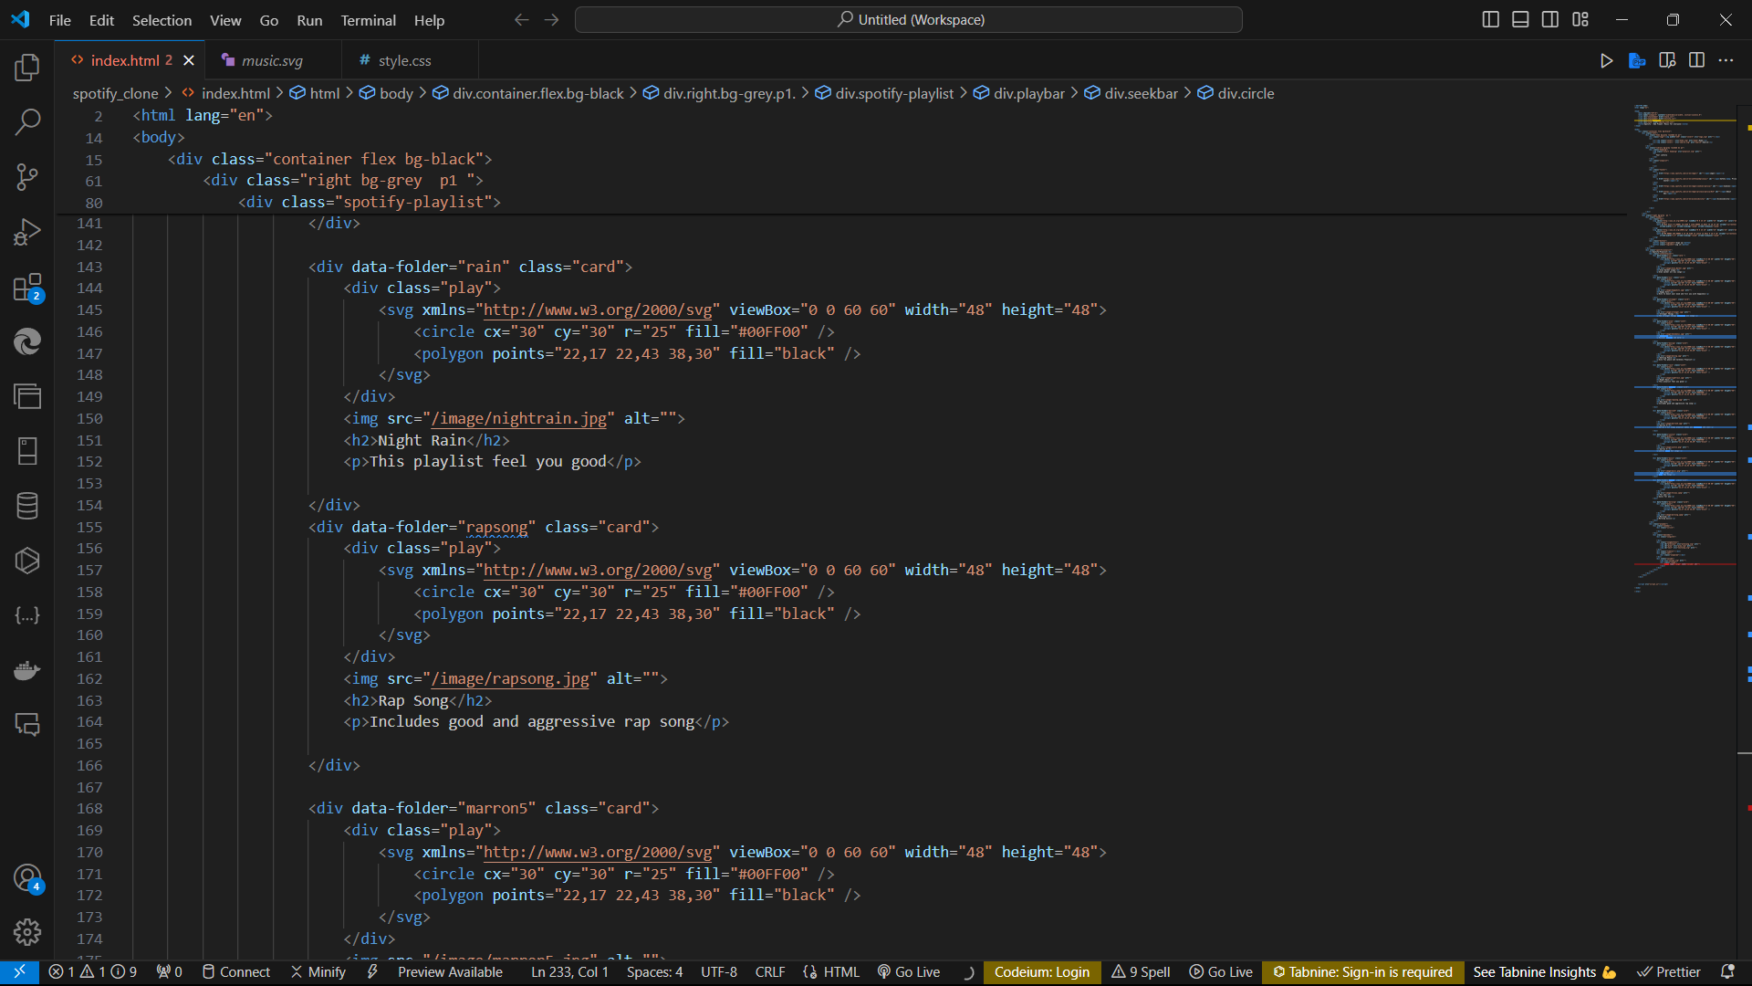
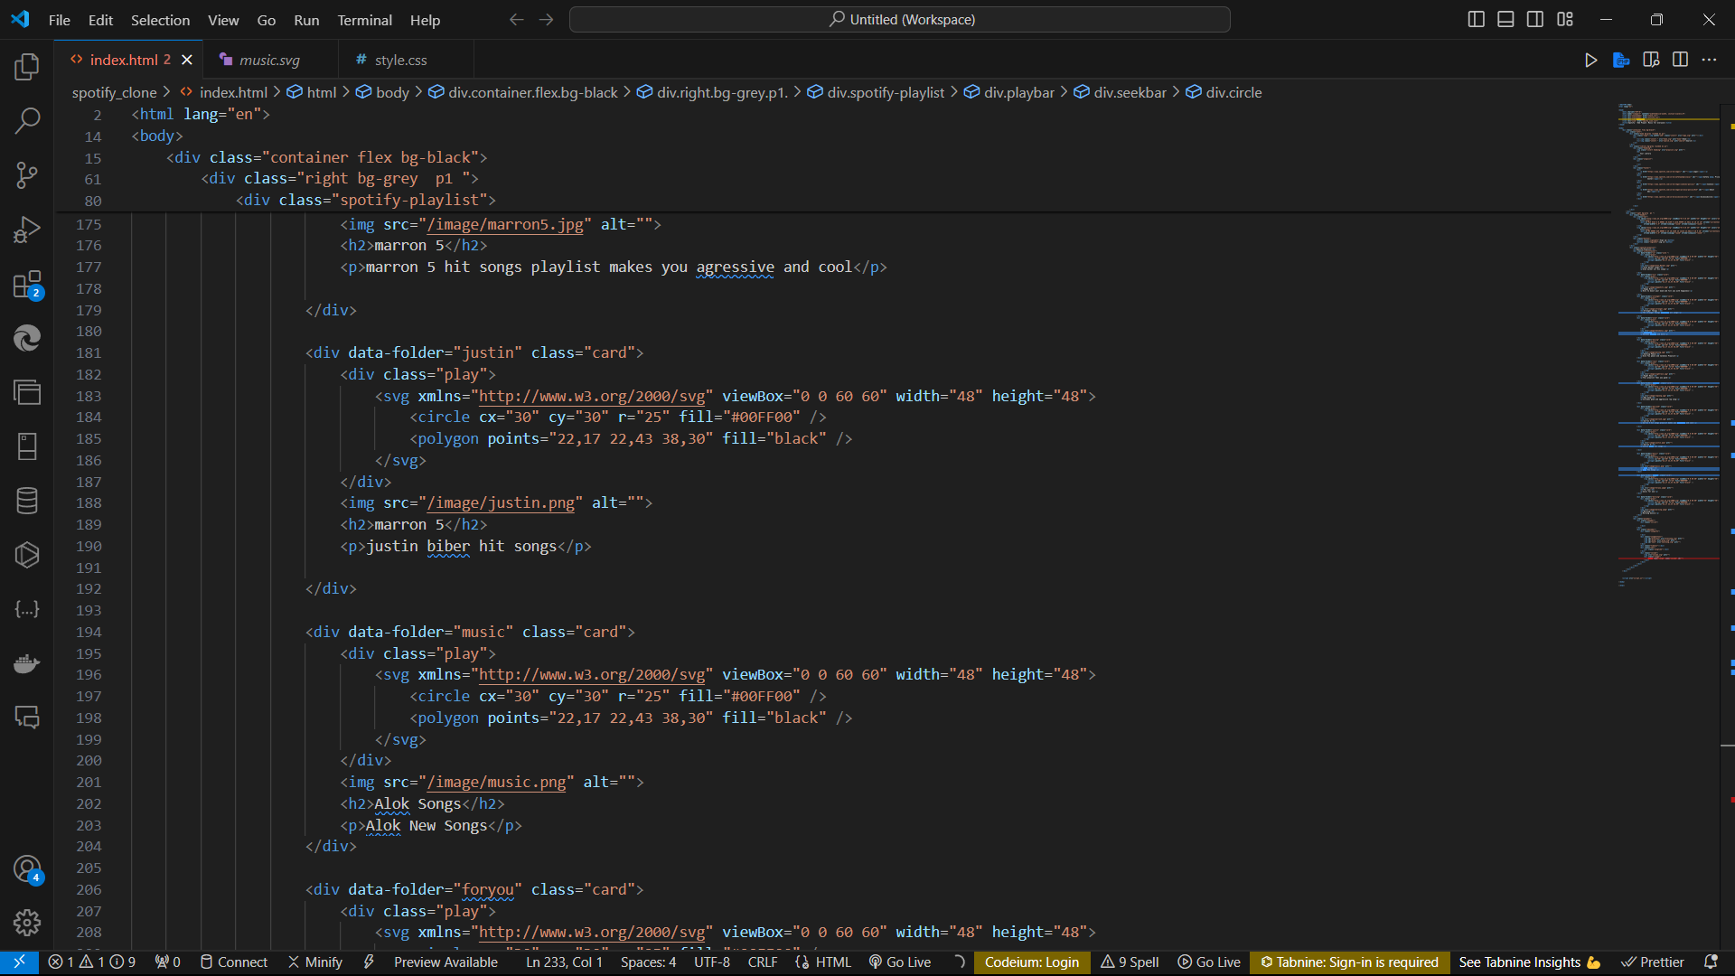
Index.html

Slide 15
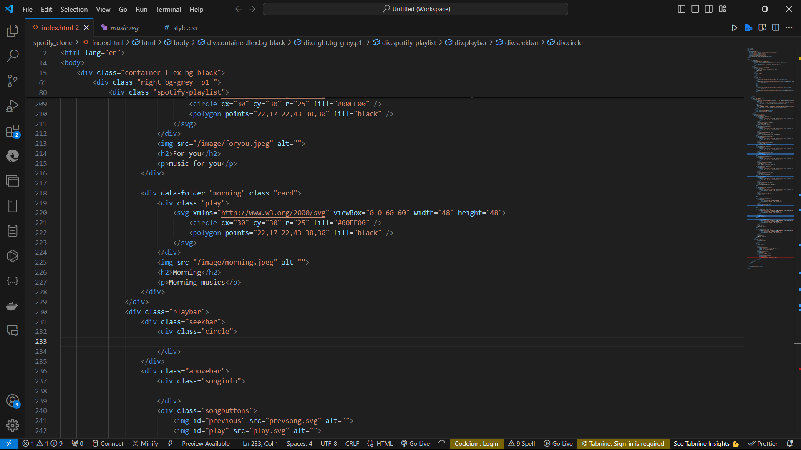
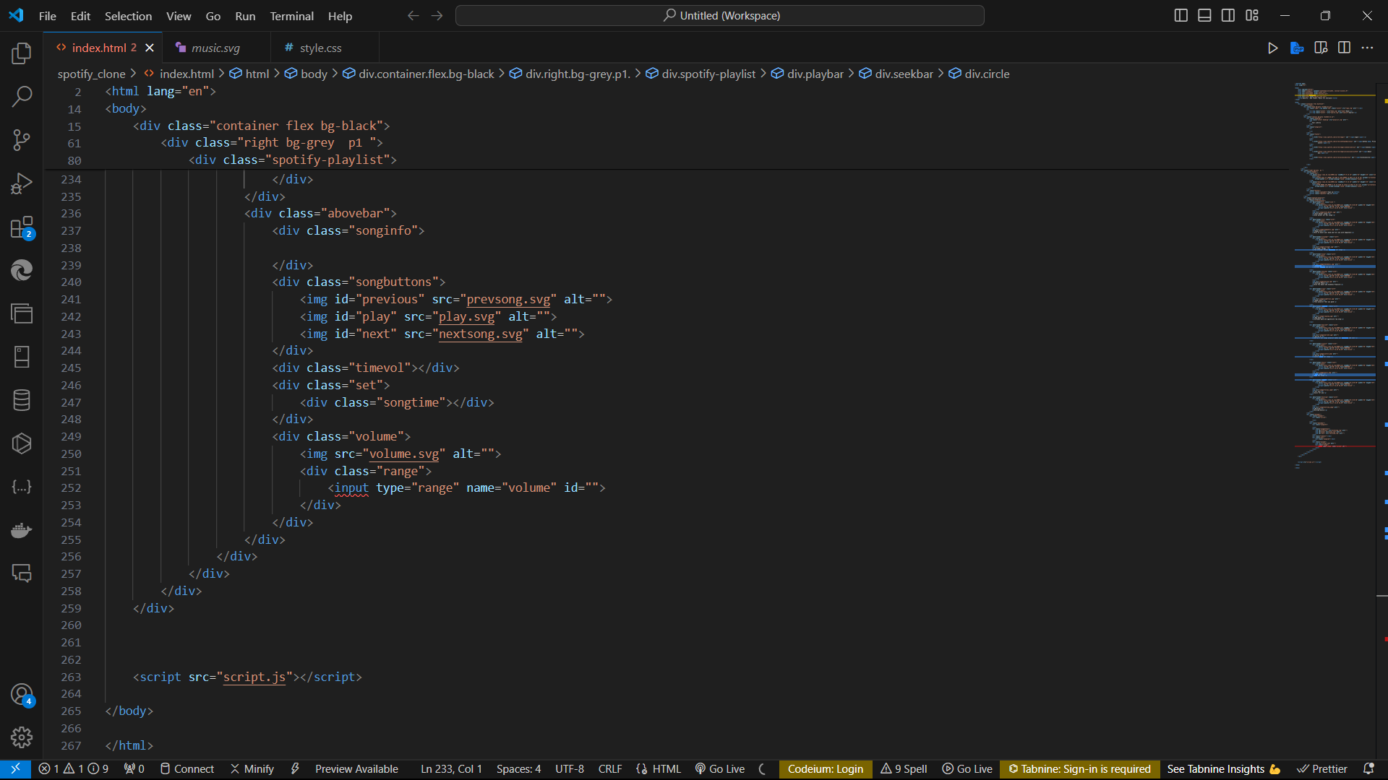
Index.html

Slide 16
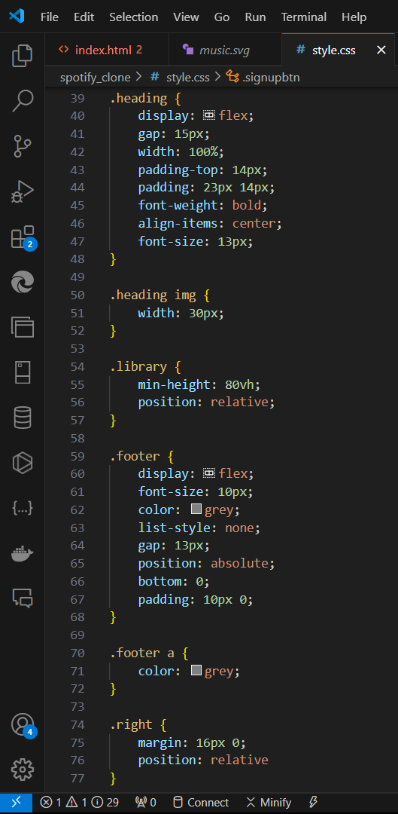
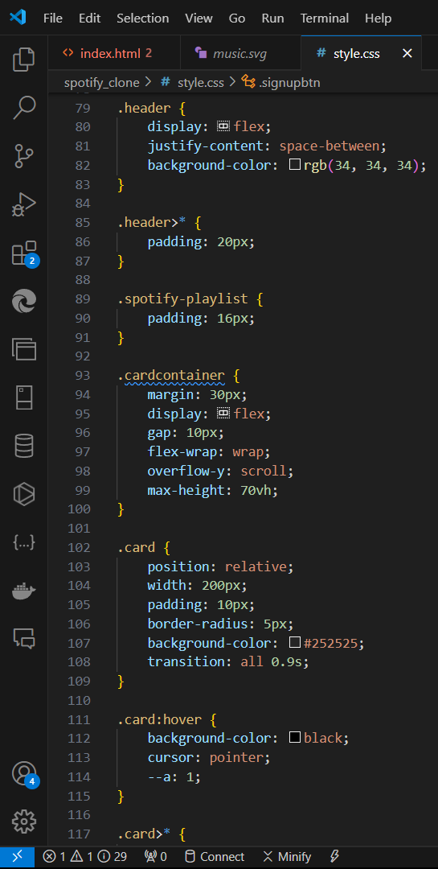
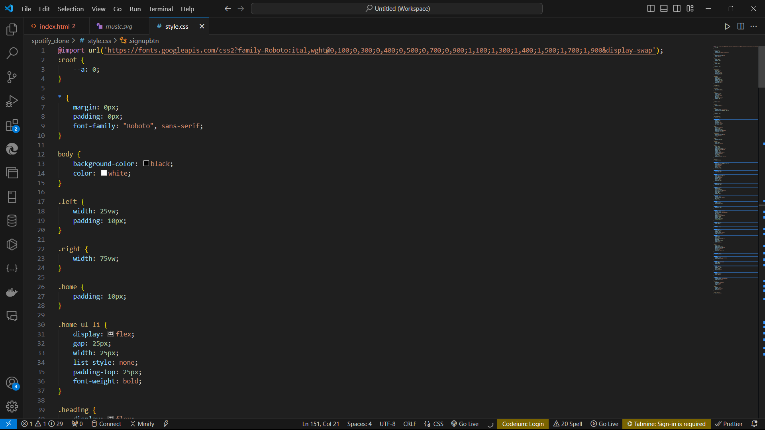
Style.css

Slide 17
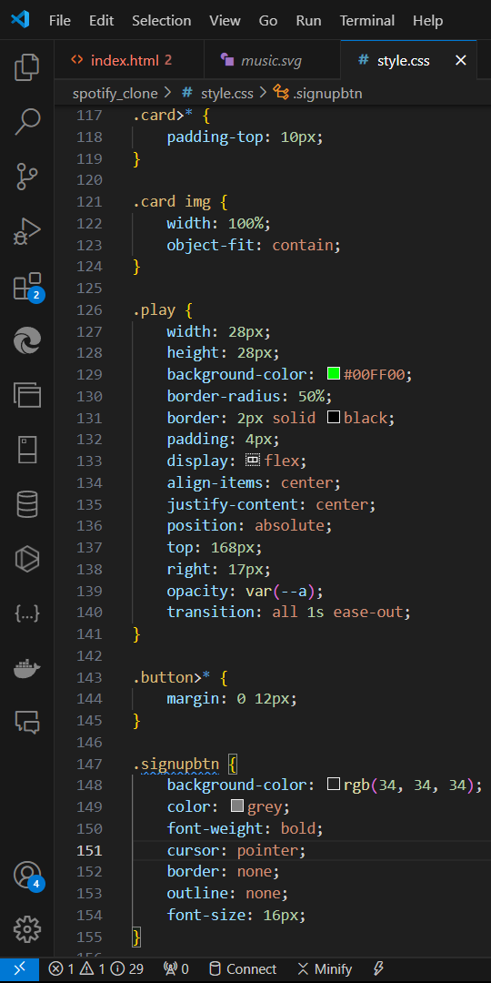
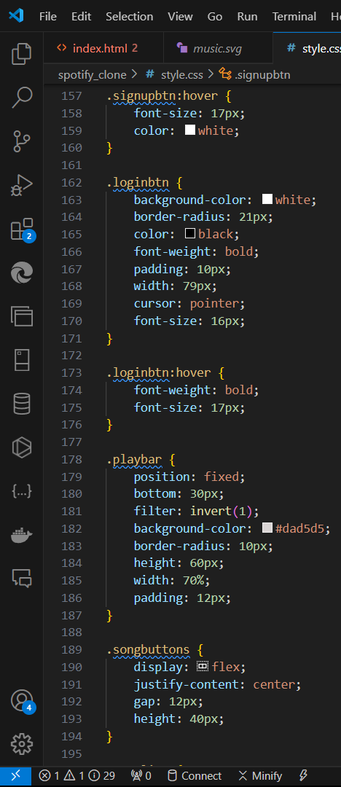
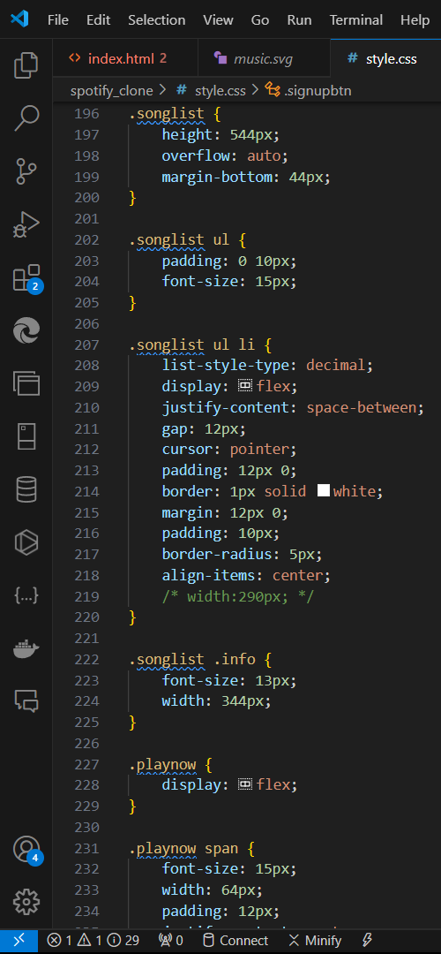
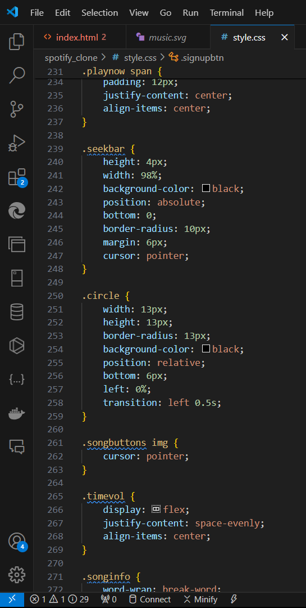
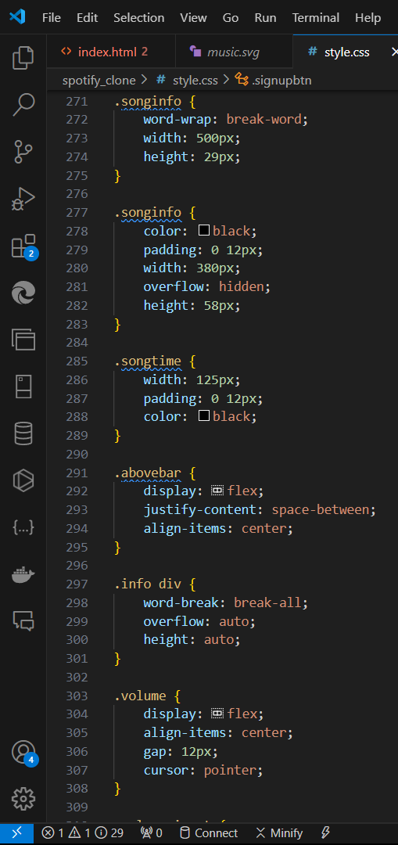
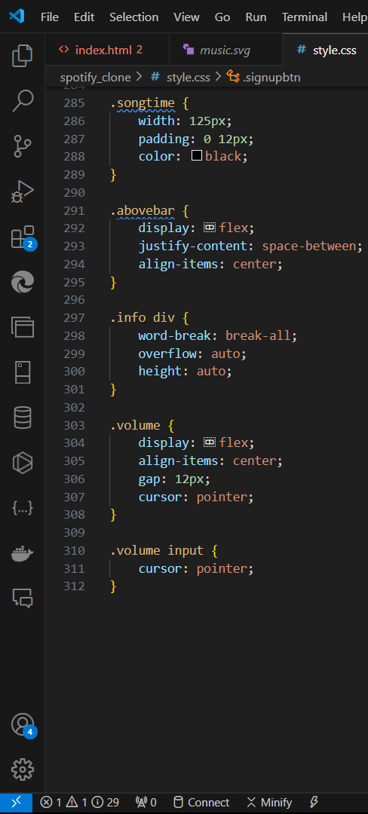
STYLE.CSS

Slide 18
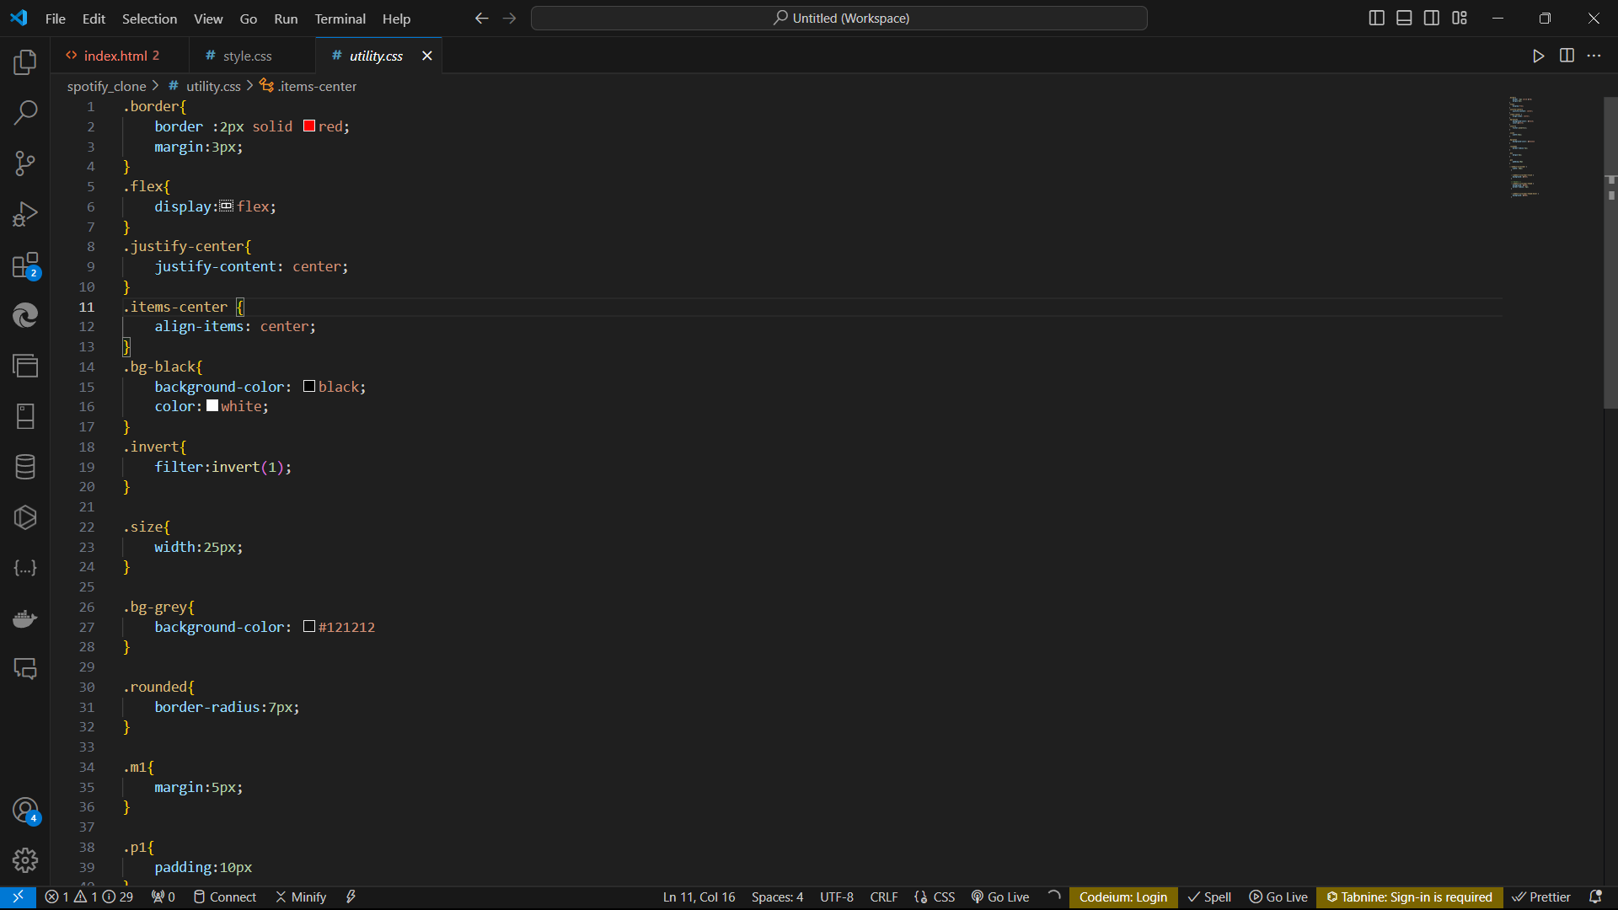
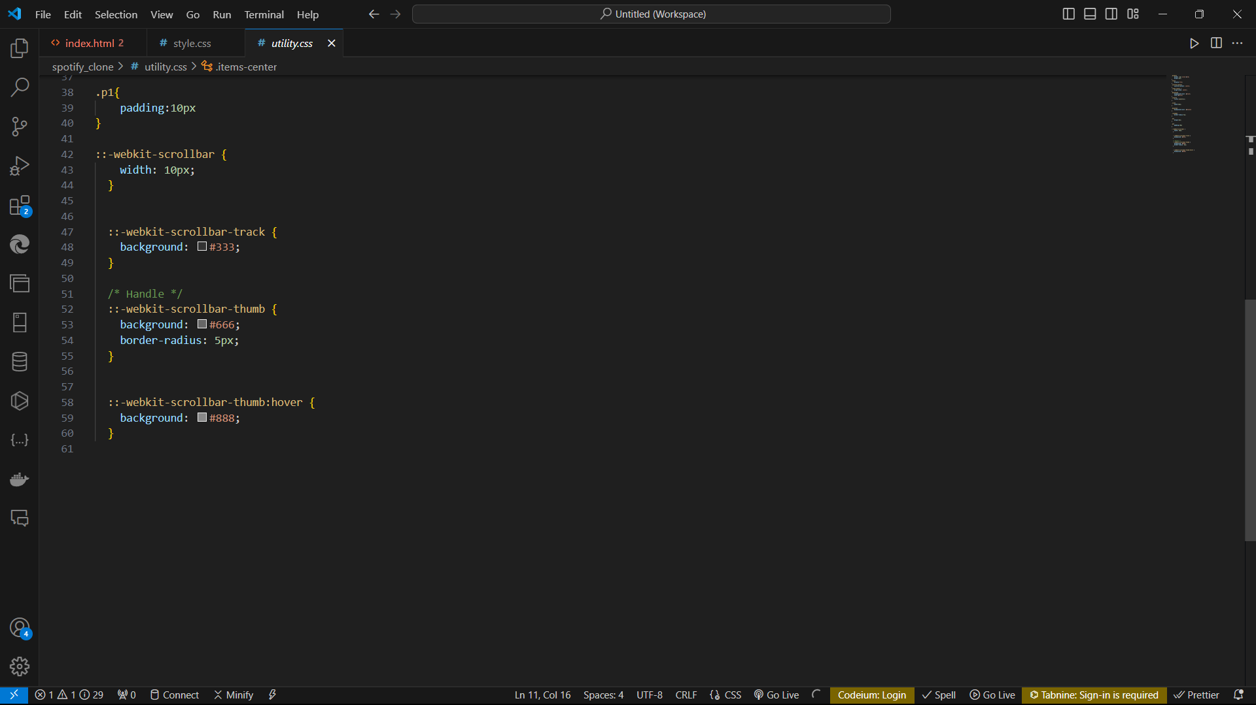
Utility.css

Slide 19
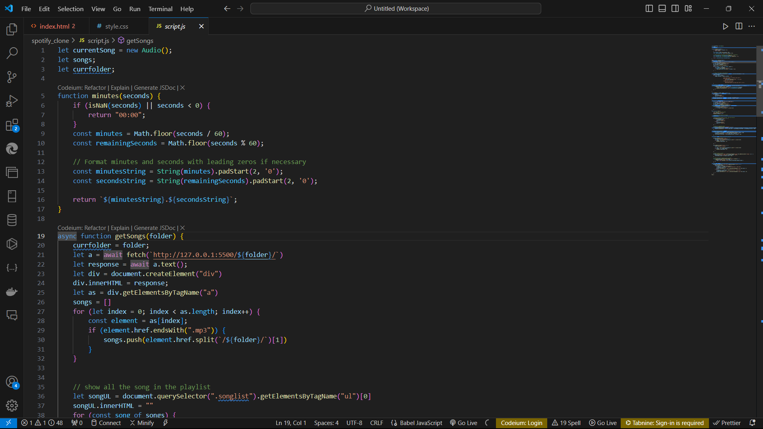
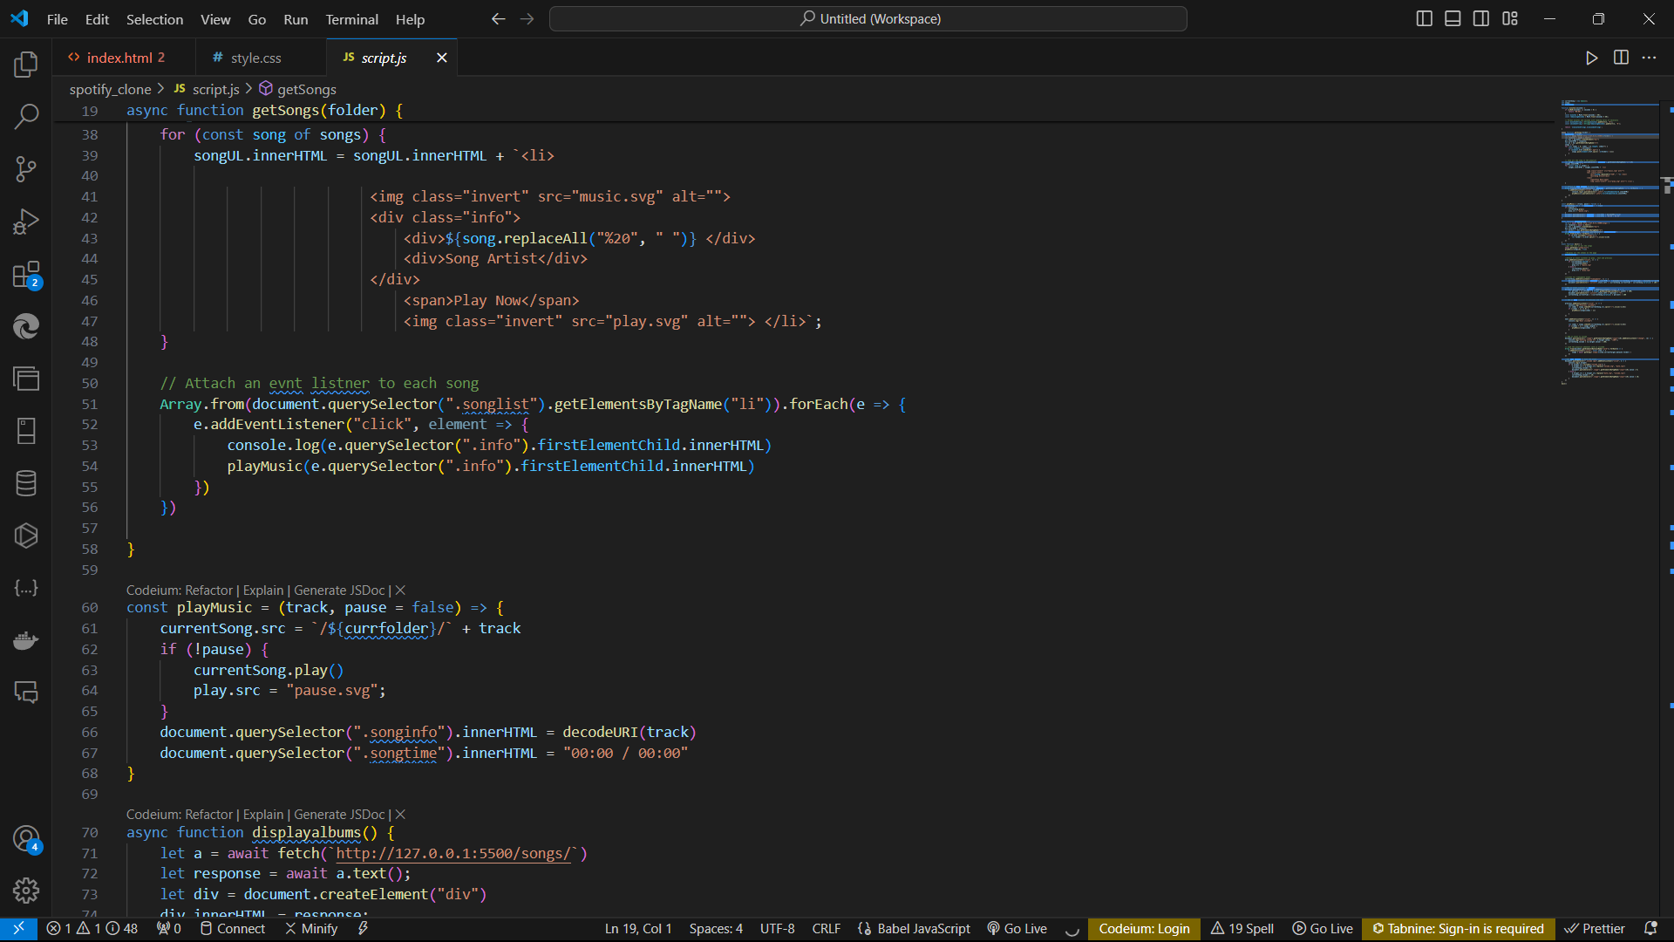
Script.js

Slide 20
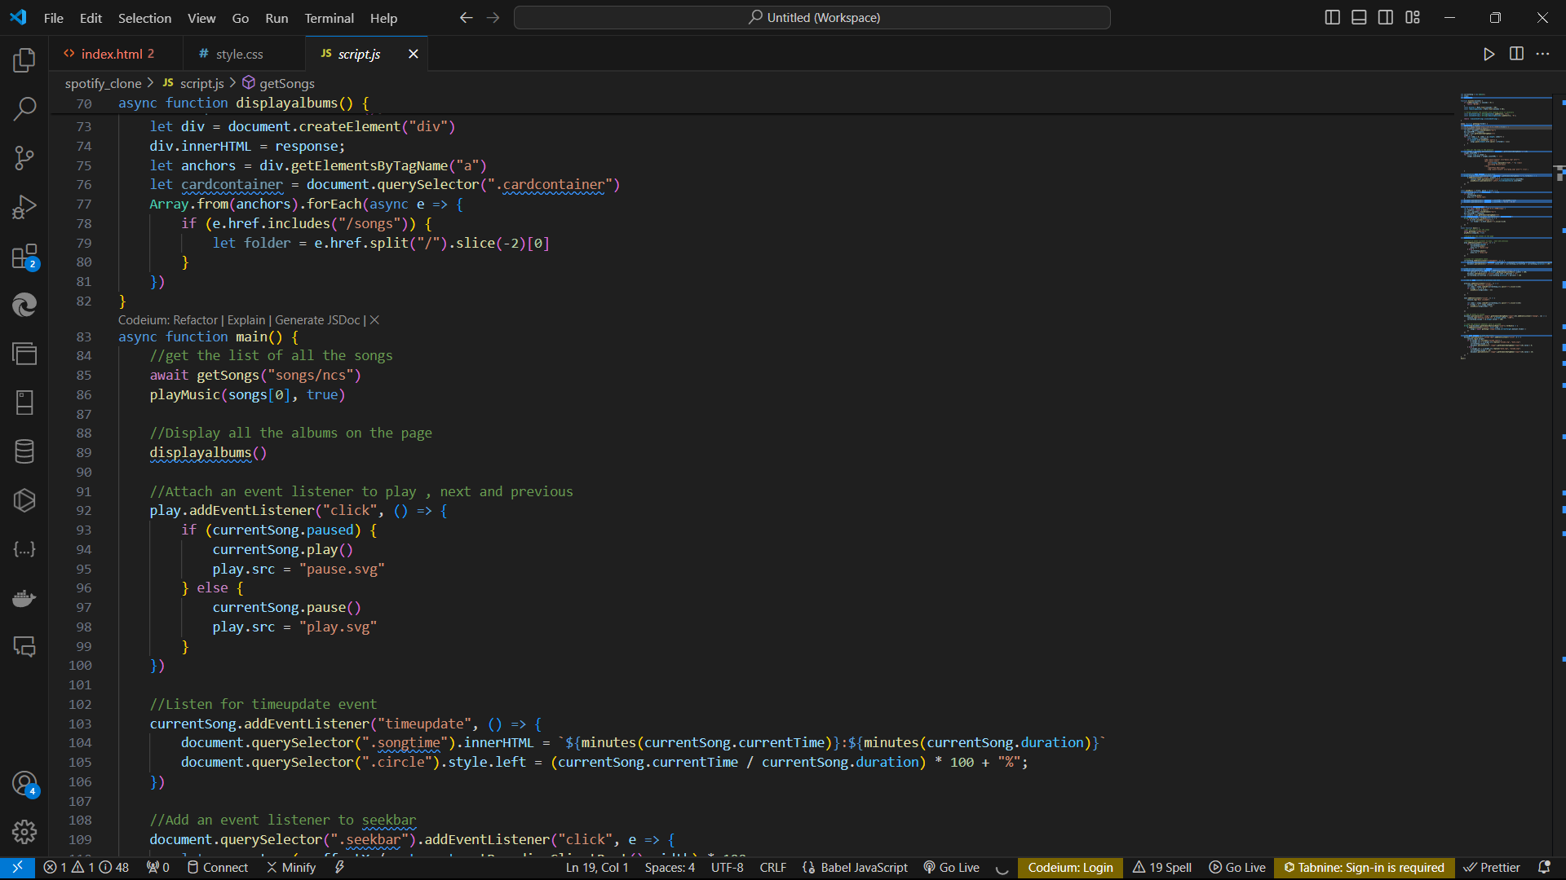
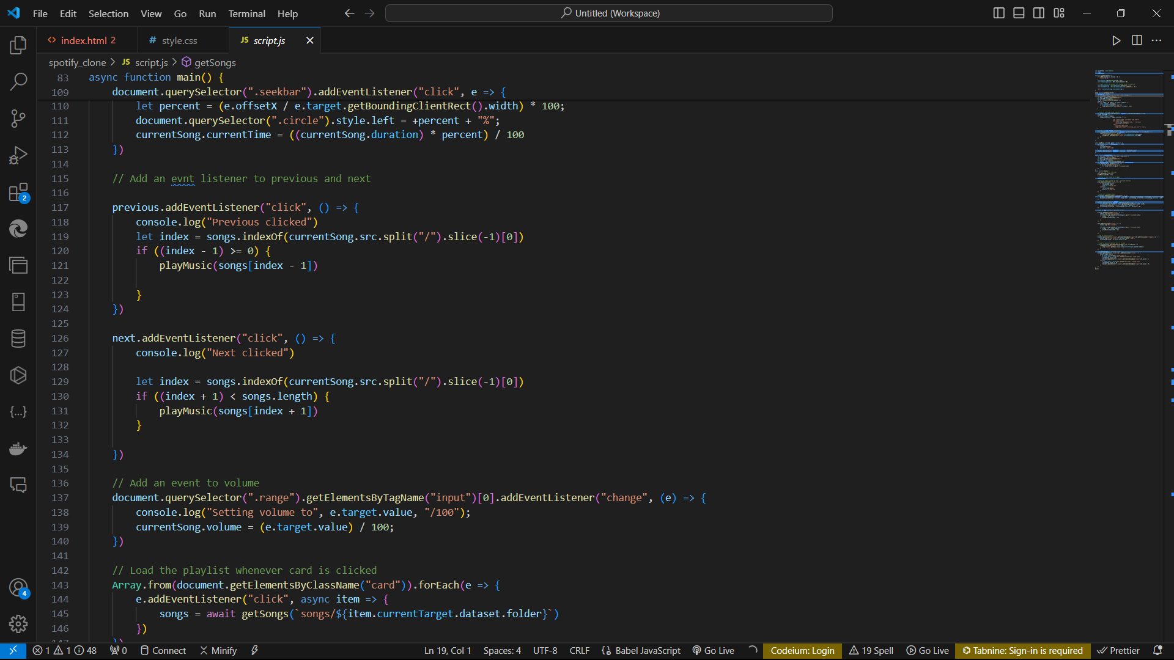
Script.js

Slide 21
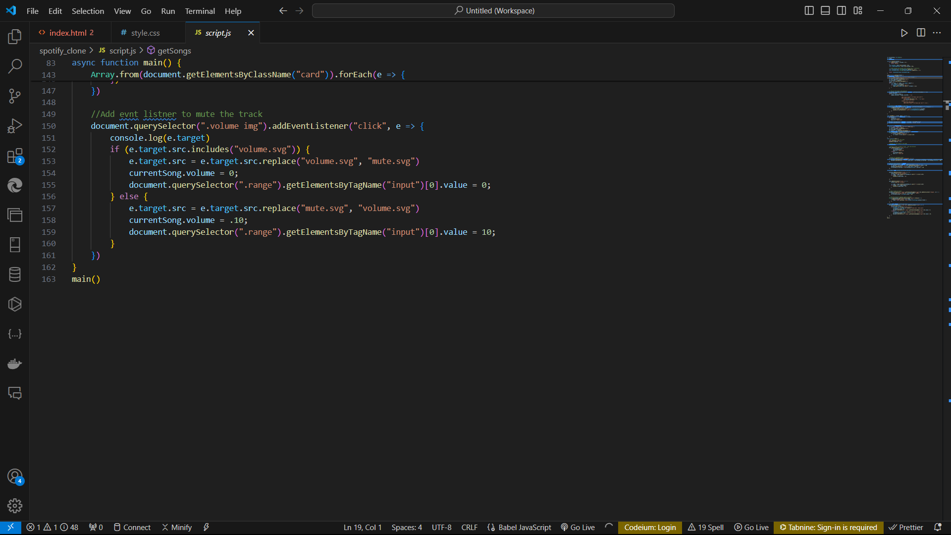
Script.js

Slide 22
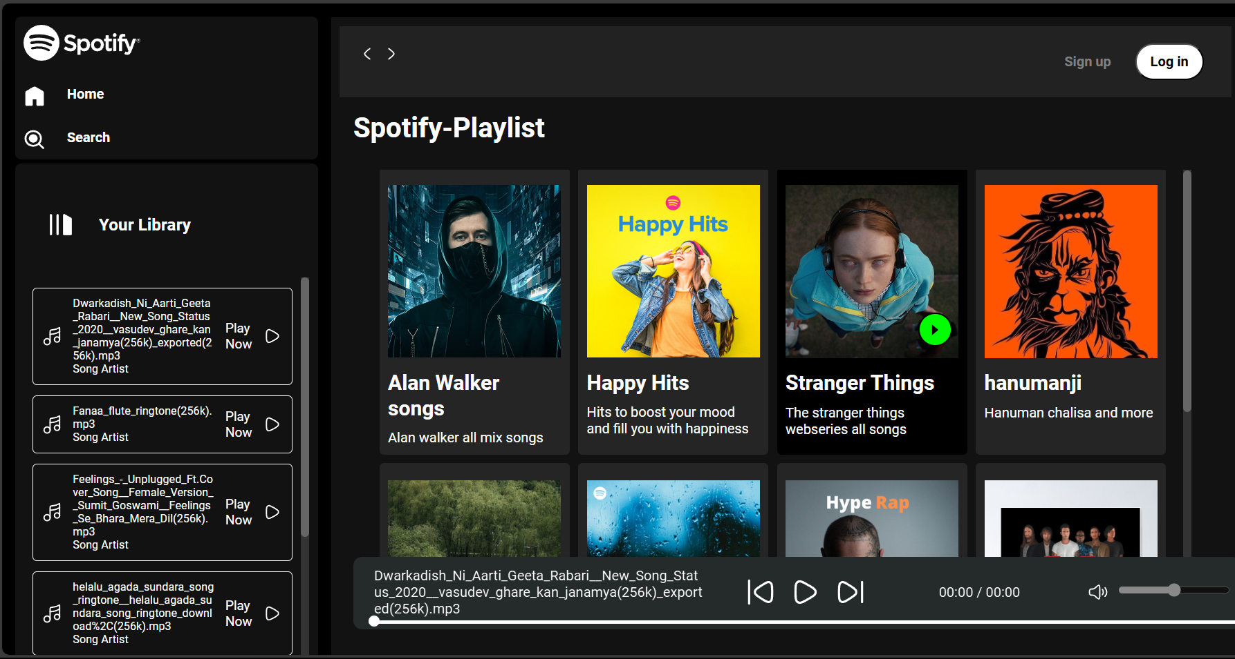
Result

Slide 23
About Spotify
A Spotify clone app is a music streaming app which provide a free plateform to listen music without downloading it.
The software is user-friendly from login to listening music. With the various features, users can enjoy listening to their favourite songs with ease.
Some music player only avalible in online .so spotify clone provide the offline plateform for users . Users will use the offline option to stream the album and listen without using the internet.
It is a freemium app also, some basic features are with adversting and limited control.
Spotify is music player app. It has 433 million monthly active users. The app is good but user has so many complained and issue about this app. Like too many Ads, low sound quality, limits of downloading songs, promotion of podcasts over music and data usage etc. These are some drawbacks of this platform. So we decide to make same music streaming platform like spotify and resolve the user’s problems and also add some additional feature in our web application

Slide 24
THANK YOU

